Slide 1

Power BI Dev in a Day
DRAFT ONLY
February 2017 update
<Insert Speaker Name>

Slide 2
3 » Developing Power BI custom visuals

Slide 3
Module outline
3 » Developing Power BI custom visuals
Core concepts
Development lifecycle
Creation
Coding
Testing
Packaging
Submission
Additional topics

Slide 4
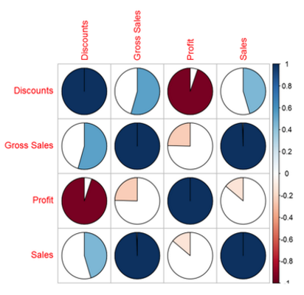
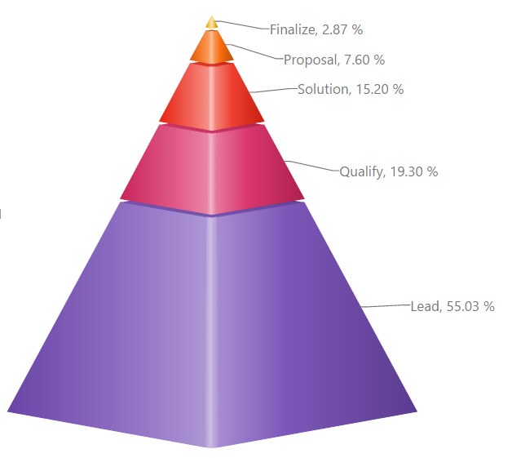
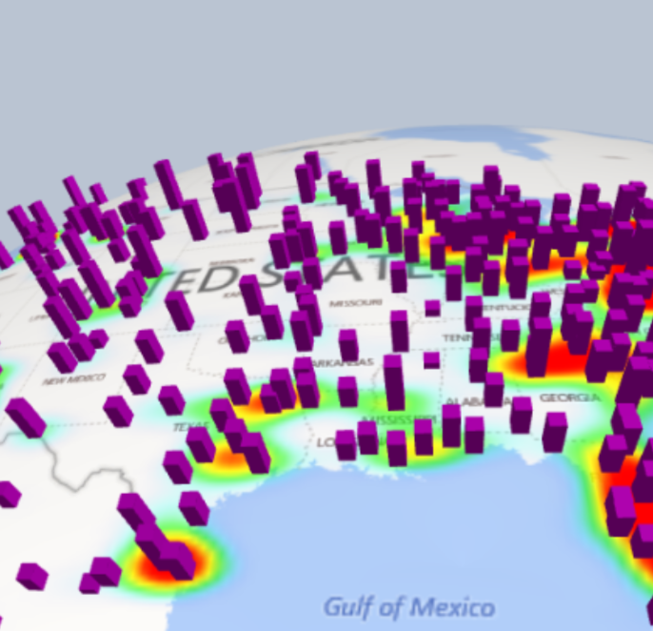

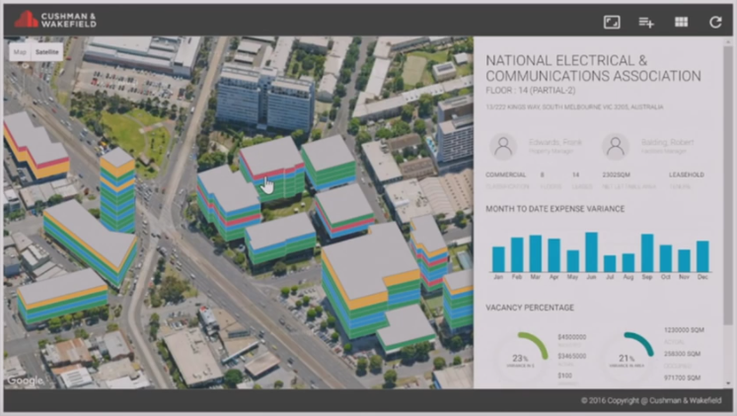

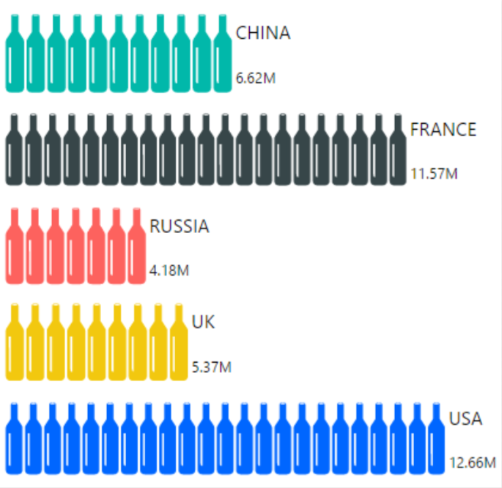
Core concepts
Developers can develop custom visuals for use in Power BI solutions which enable visualizing any data in any way

Slide 5
Core concepts
Custom visuals can be added to:
Power BI Desktop reports
Power BI service reports, and then pinned to dashboards
They behave just like the native Power BI visuals, and can:
Have formatting properties
Support filtering, highlighting, and editing
Display localized information (Power BI supports 42 languages)
R-powered custom visuals can also be developed, based on R script
Optionally, they may be submitted to the Power BI Visuals Gallery where they can become discoverable for public download and use

Slide 6
Core concepts
Development
Custom visuals can be developed on Windows, Linux or macOS
Developers will require skills with web development languages:
JavaScript
TypeScript
HTML5
SVG
CSS/Less
Typically, web drawing libraries will be used, like D3, WebGL, etc.

Slide 7
Core concepts
Framework
Custom visuals are rendered to an iFrame, into which code dependencies are injected
For stability reasons, the iFrame is sandboxed, ensuring that the visual’s code runs with low privilege, and with no domain
As a result, it is not possible to access:
Power BI styles
Power BI fonts, or
Undocumented APIs
Also, as the iFrame has no domain, it does noes have access to cookies or local storage
Notes:
https://powerbi.microsoft.com/en-us/blog/custom-visuals-sandbox/

Slide 8

Core concepts
Development prerequisites
To develop a custom visual, the following software is required:
NodeJS 4.0 (5.0, or later is recommended)
Power BI Custom Visual Tool (this content describes v1.4.0)
A source code editor—Visual Studio Code is recommended
Visual Studio Code is a free open source code editor developed by Microsoft for Windows, Linus and macOS

Slide 9
Core concepts
Development prerequisites
Install the Power BI Custom Visual Tool with a single command
Additionally, a localhost certificate must be installed on the computer used to develop/test the custom visual
Testing is achieved with the Power BI service, and the developer’s computer will start the custom visual as a service
npm install -g powerbi-visuals-tools

Slide 10
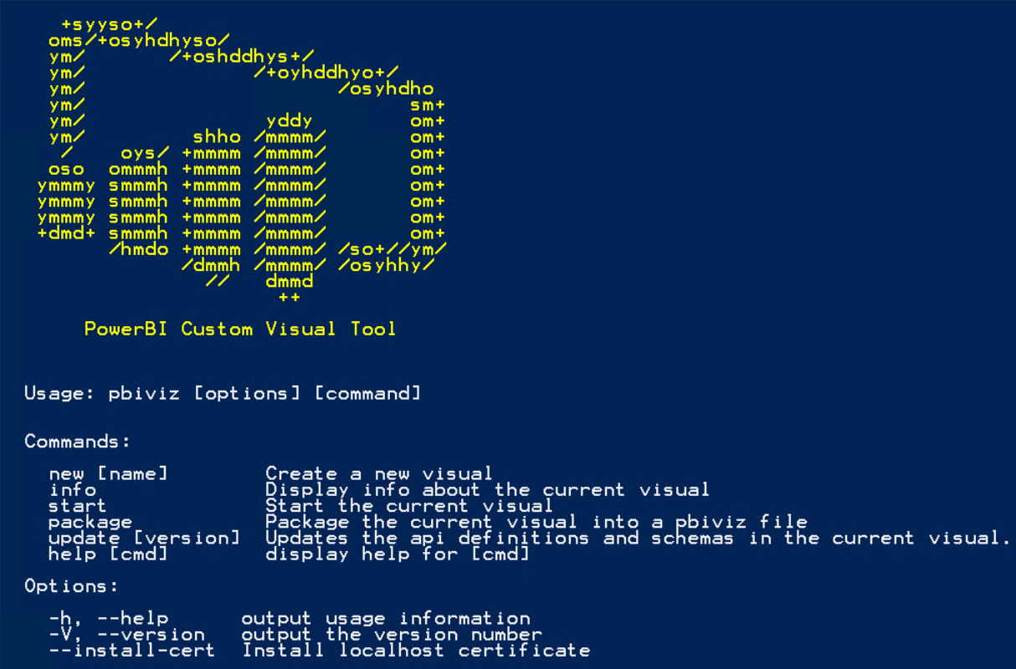
Core concepts
Power BI Custom Visual Tool
Commands include:
New
Info
Package
Update
Help
An option assists installing a localhost certificate which supports testing

Slide 11

Core concepts
Development lifecycle
Custom Visual Tool
Creation
Coding
Testing
Packaging
Submission
Gallery
Developer
Optional
End user
Visual API
(versioned)
PowerBI.com

Slide 12
Development lifecycle
The development lifecycle consists of the following phases:
Creation
Coding
Testing
Packaging
Submission

Slide 13
Development lifecycle
1 – Creation
Custom Visual Tool
Creation
Coding
Testing
Packaging
Submission
Gallery
Developer
Optional
End user
Visual API
(versioned)
PowerBI.com

Slide 14
Development lifecycle
1 – Creation
A custom visual project is created with a single command
The command creates a new folder, and generates a basic starter template
The project structure includes many folders and files
Versioned API type definitions and JSON schemas are copied into the project directory
pbiviz new <CustomVisualName>

Slide 15
Development lifecycle
1 – Creation: Project structure
Project item | Description
assets/ | Folder for visual assets (visual icon, etc.)
dist/ | Folder where the pbiviz file will be generated
src/ | Folder for TypeScript code for the visual
style/ | Folder for Less styles
capabilities.json | File used to define the visual capabilities (data roles, data view mappings, and options)
package.json | File used by npm to manage modules
pbiviz.json | Main configuration file for the visual
tsconfig.json | File used for TypeScript compiler settings. All file dependencies must be registered in this file.

Slide 16
Development lifecycle
2 – Coding
Custom Visual Tool
Creation
Coding
Testing
Packaging
Submission
Gallery
Developer
Optional
End user
Visual API
(versioned)
PowerBI.com

Slide 17
Development lifecycle
2 – Coding
The developer codes the custom visual capabilities, and visual logic and behavior
The custom visual declares its capabilities in the capabilities.json file
Capabilities declares functionality, including the user interface
The two most important are dataRoles and dataViewMappings

Slide 18
Development lifecycle
2 – Coding: Capabilities
Capability | Description
dataRoles | Describes the fields, and field types (measure, category, or both)
dataViewMappings | Describes how the data roles relate to each other, and allows specifying conditional requirements for the them. Most visuals provide a single mapping, but it is possible to provide multiple dataViewMappings. Each valid mapping will produce a dataview.
objects | Describes customizable formatting properties
supportsHighlight | Describes whether to allow handling partial highlighting (true/false)
sorting | Describes that sorting can be implemented

Slide 19
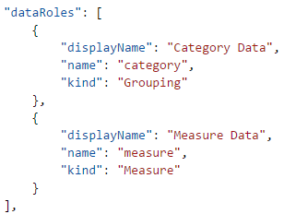
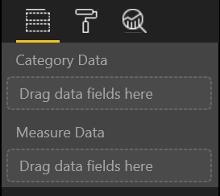
Development lifecycle
2 – Coding: Capabilities: Data roles

Slide 20
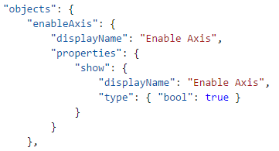
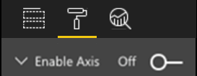
Development lifecycle
2 – Coding: Capabilities: Objects

Slide 21
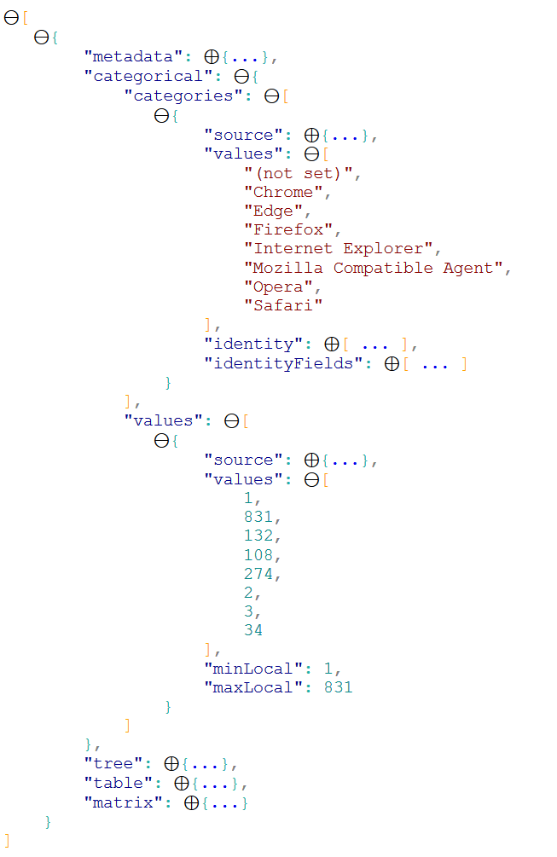
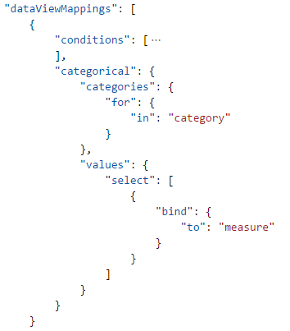
Development lifecycle
2 – Coding: Capabilities: Dataview

Slide 22
Development lifecycle
2 – Coding: Languages
Custom visual code must be written in TypeScript
All TypeScript files should be stored in the src/ folder, and added to the files array in the tsconfig.json file
When the visual is built, all TypeScript files are compiled into a single JavaScript file
Custom visual styling is handled by using CSS
The Less compiler is used, supporting advanced features including nesting, variables, mixins and conditional loops
All Less files should be stored in the style/ folder
There is no need (nor ability) to define the data retrieval logic
The dataRoles and dataViewMappings enable Power BI to retrieve/filter data

Slide 23
Development lifecycle
2 – Coding: Visual lifecycle
The visual lifecycle includes three phases
Power BI continually draws the visual over and over again, typically in response to new data and visual resizing
Init
Update
Destroy

Slide 24
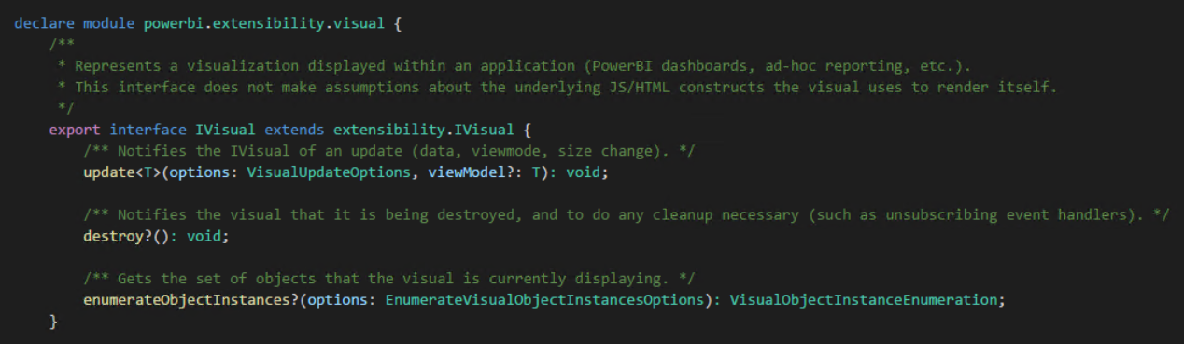
Development lifecycle
2 – Coding: Visual
The visual is developed in a single class which implements IVisual

Slide 25
Development lifecycle
2 – Coding: Visual: Methods
The constructor can be used to initialize the visual state
The IVisual interface defines the following methods:
Method | Description
update | Notifies the visual of an update (data, view mode, size change, etc.). Most of the visual logic is coded in this method.
destroy | (Optional) Notifies the visual that it is being destroyed, and so can be used to clean up resources or state, e.g. unsubscribing event handlers. This method is rarely used, as Power BI will destroy the iFrame used to host the visual.
enumerateObjectInstances | Gets the set of objects that the visual is currently displaying. Must be overridden if custom formatting options are added to the visual capabilities.

Slide 26
Development lifecycle
2 – Coding: Visual: Constructor
The constructor receives the options object, which provides references to the hosting iFrame and IVisualHost
IVisualHost provides:
Selection builders and managers
Color palette
Tooltip service
Locale (i.e. language, en-US, etc.)

Slide 27
Development lifecycle
2 – Coding: Visual: Update method
Most of the visual logic is coded in the update method
The update method receives the options object, which provides references to:
The viewport (visual height/width)
Dataview(s) (query results, and related metadata)
Type of update (data, resize, view mode, style, resize end), and
View mode (reading, or editing mode)

Slide 28
Development lifecycle
3 – Testing
Custom Visual Tool
Creation
Coding
Testing
Packaging
Submission
Gallery
Developer
Optional
End user
Visual API
(versioned)
PowerBI.com

Slide 29
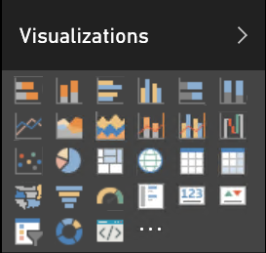
Development lifecycle
3 – Testing
To enable testing, the developer must sign in to the Power BI service
It is not possible to test a custom visual with Power BI Desktop
In Power BI Settings, the Enable Developer Visual for Testing setting must be enabled
In a report, the Developer Visual will be made available, and can be added to the report canvas

Slide 30
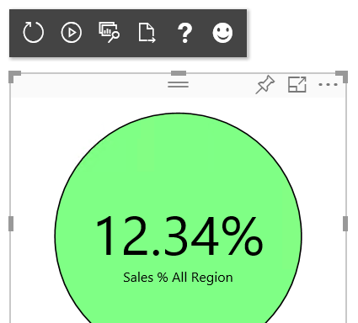
Development lifecycle
3 – Testing
A custom visual project is started with a single command
The command rebuilds the project and starts a local server hosting the visual
The Power BI service connects to the server, enabling the Developer Visual to render the visual
A toolbar is available above the visual
pbiviz start

Slide 31
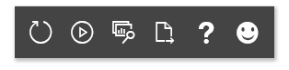
Development lifecycle
3 – Testing: Developer Visual toolbar
Reload Visual Code
Show Dataview
Help
With each project rebuild, click Reload Visual Code, or turn Toggle Auto Load on to automatically update upon each rebuild
Use Show Dataview to reveal—and then explore and interact with—the visual’s dataview(s)
Use Export Dataview to download a JSON document of the data view(s)
Toggle Auto Load
Export Dataview
Send Feedback

Slide 32
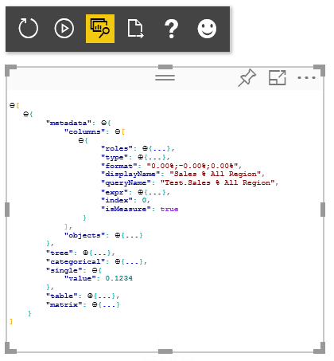
Development lifecycle
3 – Testing: Show Dataview

Slide 33
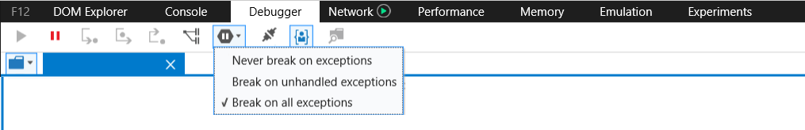
Development lifecycle
3 – Testing: Debugging
With each rebuild, the visual’s JavaScript is recompiled, and so breakpoints cannot be persisted
To work around this, use debugger statements in the code
Error messages will not be surfaced by the Power BI service, and so they should be caught and logged
It is also possible to set the browser to break on caught exceptions which will stop code execution
Notes:
https://github.com/Microsoft/PowerBI-visuals/blob/master/tools/debugging.md

Slide 34
Development lifecycle
4 – Packaging
Custom Visual Tool
Creation
Coding
Testing
Packaging
Submission
Gallery
Developer
Optional
End user
Visual API
(versioned)
PowerBI.com

Slide 35
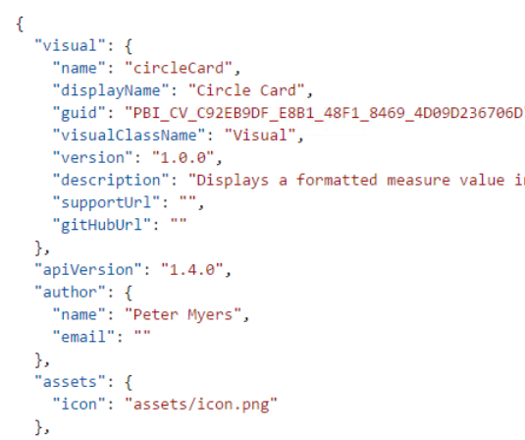
Development lifecycle
4 – Packaging
Before packaging the visual, ensure that the pbiviz.json file is configured, with:
A friendly display name
Description
Author details
Reference to assets, including an icon to be displayed in the visualizations pane
Must be 20px x 20px
Supported formats: png, jpg/jpeg or svg

Slide 36
Development lifecycle
4 – Packaging
A custom visual project is packaged with a single command
A pbiviz file is then output to the dist folder
The file is completely portable, and contains versioned resources and all dependencies
The file can then be imported into a Power BI Desktop report, or a Power BI service report
pbiviz package

Slide 37
Development lifecycle
5 – Submission
Custom Visual Tool
Creation
Coding
Testing
Packaging
Submission
Gallery
Developer
Optional
End user
Visual API
(versioned)
PowerBI.com

Slide 38
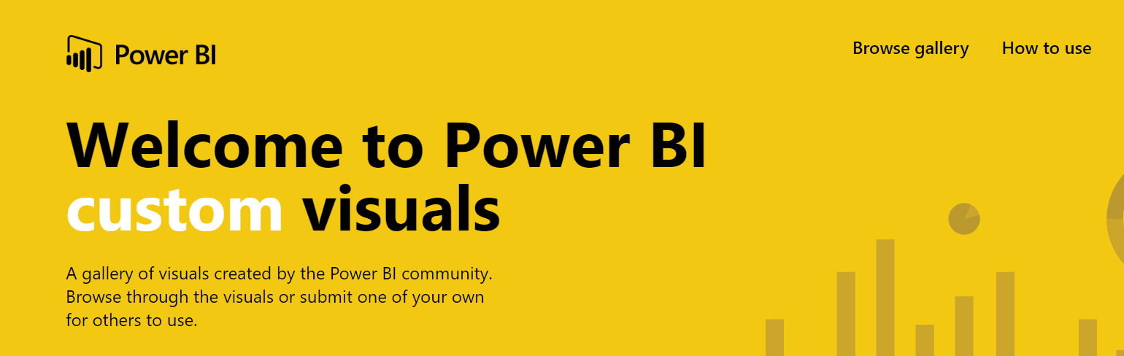
Development lifecycle
5 – Submission
The custom visual can be submitted to the Power BI Visuals Gallery
To be accepted, it must pass acceptance criteria, and pass all test cases

Slide 39
Development lifecycle
5 – Submission
Submission flow:
Author submits a visual package and content
Microsoft Custom Visuals Team reviews the submission
Author corrects any issues, and re-submits
Once all blocking issues have been resolved, author provides sample report, blog post and demonstration video
Microsoft Custom Visuals Team publishes the visual to the Visuals Gallery

Slide 40
Additional topics
Custom visuals utilities
Updating the API version
R-powered custom visuals

Slide 41
Additional topics
Custom visuals utilities
Available at https://github.com/Microsoft/powerbi-visuals-utils-...
Utility | Description
chartutils | Set of functions and classes to manage chart axes and labels
colorutils | Set of functions and classes to simplify color manipulations
dataviewutils | Set of functions and classes to simplify parsing of the Dataview object
formattingutils | Set of functions and classes to format values
interactivityutils | Set of functions and classes to simplify working with cross-selection and cross-filtering
svgutils | Set of functions and classes to simplify SVG manipulations
testutils | Set of mocks and fakes to simplify unit testing
tooltiputils | Set of functions and classes to simplify usage of the Tooltip API
typeutils | Set of functions and classes to extend the basic types

Slide 42
Additional topics
Updating the API version
When the visual is created, versioned API type definitions and JSON schemas are copied into the project directory
Updating a visual is not required, but can be useful if Microsoft releases a fix for a past API version, or to benefit from new capabilities delivered in a later API version
Use the following command to update these files if needed
You can also update to a different API version by explicitly specifying an API version in the update command
pbiviz update

Slide 43
R-powered custom visuals
It is also possible to develop R-powered custom visuals
They are based on R script
The visual can perform analytical and statistical analysis to create compelling visuals by integrating with R

Slide 44
Resources
Power BI Visuals Gallery
https://visuals.powerbi.com/
Getting started
http://aka.ms/pbivizstart
Documentation
https://github.com/Microsoft/PowerBI-visuals
Visual Tools: https://github.com/Microsoft/PowerBI-visuals-tools
Submit your visual:
https://github.com/Microsoft/PowerBI-visuals/blob/master/Tutorial/SubmittingToGallery.md

Slide 45
Resources
R-powered Custom Visuals
https://github.com/Microsoft/PowerBI-visuals#building-r-powered-custom-visual-corrplot

Slide 46
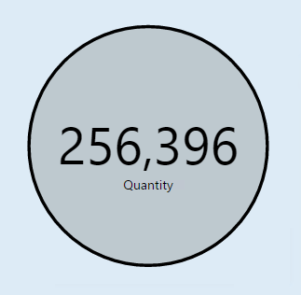
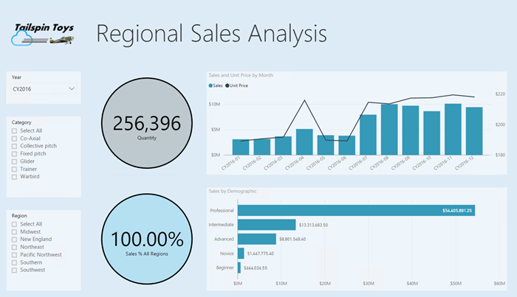
Lab 03A
90 minutes
Developing a Power BI Custom Visual
Creating a Custom Visual
Adding Visual Elements
Configuring Data Binding
Installing Power BI Utilities
Formatting Data Values
Adding Formatting Options
Packaging the Custom Visual
Importing the Custom Visual

Slide 47
Questions?

